Slide 1



Care Sync
Team names

Slide 2


Project Objectives
CareSync opens a real life scenario of a patient experiencing a harmful medical error due to a missed medication. The presentation uses compelling statistics on the global impact of medical errors ,drawing immediate attention to importance of the issue . The goal is to make the audience feel the urgency and relevance of the problem. | CareSync reduces medical errors by offering medication tracking system ,immune risk graphing and error logging in one console based tool. Its accessible design makes it ideal for patients ,caregivers and clinics with limited resoures. The app turns a common challenge –managing medication –into a proactive health –preserving solution. | By combining practicality ,empathy and innovation , CareSync stands out .Its unique immune system risk feature adds a powerful layer of health awareness. The project’s presentation concludes with a strong call to action ,inviting stakeholders to scale the project and help saves lives.

Slide 3

The Problems to Solve
01
High frequency of medical errors such as missed doses, incorrect prescriptions and misdiagnoses.
02
Users; elderly patients , caregivers and small clinics for medication reminders e.t.c
03
CareSync addresses these issues by integrating medication logging e.t.c

Slide 4


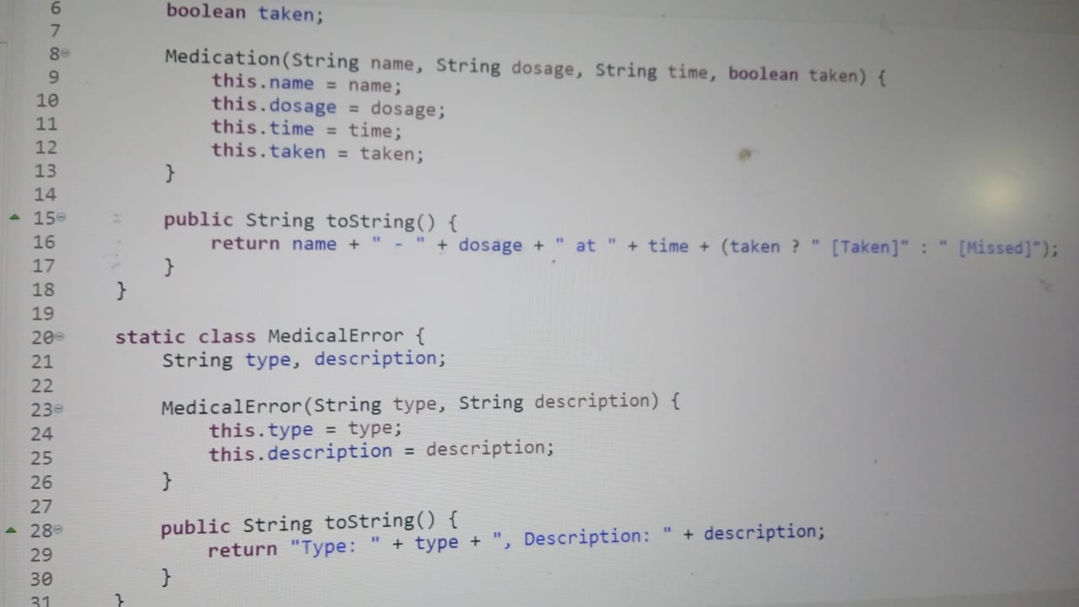



Offered Solutions
01.
02.
03.
Innovation
Collaborative Team
Growth Potential

Slide 5



Next Steps
Presenter Challenges
We struggled to make the app user friendly, researching real-world medical practices to simulate immune deterioration risks and building and testing within the time-frame.

Slide 6

Thank You.

